Slide 1
Youth Apprenticeship Program
Your School Logo

Slide 2
What is Youth Apprenticeship?
Youth Apprenticeship (YA) is a rigorous statewide elective program for high school juniors and seniors that combine academic and technical classroom instruction with mentored on-the-job learning. It’s an opportunity for students to experience a career while still in high school.

Slide 3
How does this work?
Students attend their home high school and continue taking courses required to meet graduation requirements along with technical coursework, which follows industry standards.
Students work 10-20 hours per week during the school year and are encouraged to work during the summer depending on business needs.

Slide 4
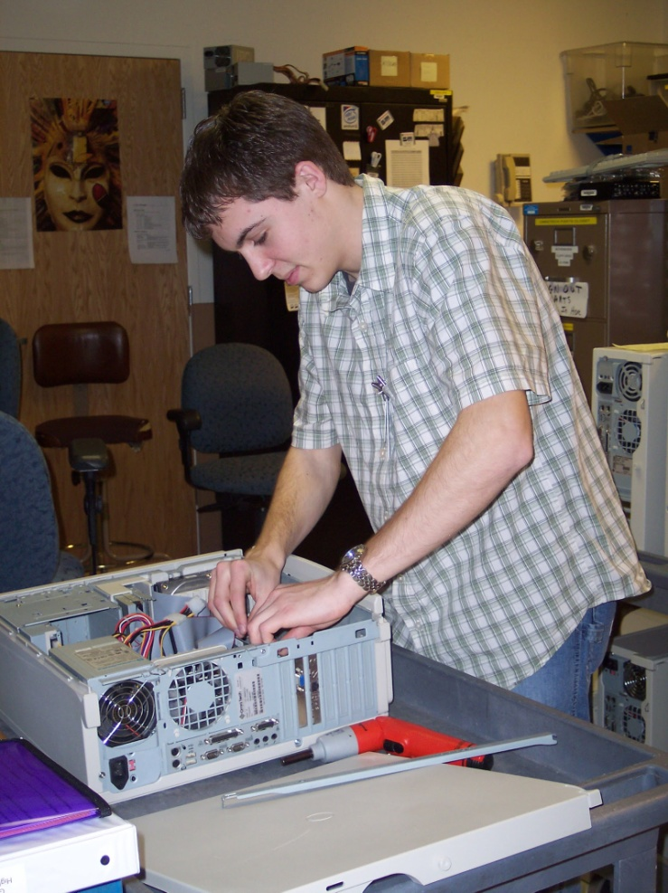
How does this work?
Employers provide wages, worker's compensation, competency training, and mentoring.
Students who master the competencies and graduate from high school, receive a state issued skills certificate. Students may be eligible for advanced standing at a technical college offering a similar program.

Slide 5
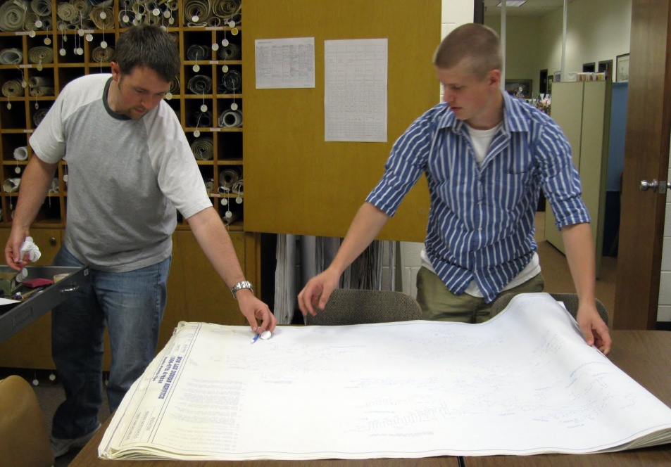
How does this work?
There is no commitment from the employer to hire the student or for the student to remain with the employer after graduation. However, successful experiences have resulted in the student continuing with their employer.

Slide 6
Yes… You can still go to College!
Upon completion, all post-secondary options are still open to students:
University
Two-year technical programs
Adult apprenticeships
Other industry training programs -Military etc
And/or employment.
It is important that you communicate your post-secondary plans with their counselor so all academic requirements are met.

Slide 7
Benefits to the student
Develop strong academic and technical skills
Learn to handle responsibility, develop good work habits, learn problem solving, time management and team work required of skilled adults
See first-hand connection between education and real-life work skills
Earn wages during the program
Master the required program competencies and receive a state-issued certificate of occupational proficiency
Possibly gain advanced standing or receive transcripted credit at a technical college

Slide 8
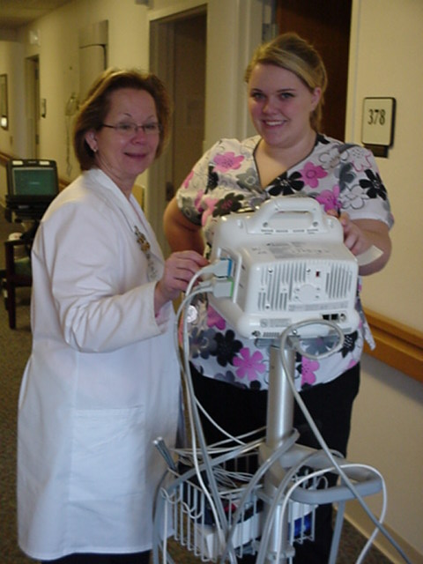
To be a successful Youth Apprentice you must . . .
Be committed (to spending one year in the career experience and giving it 100%)
Learn from your mistakes (you will make them – they expect you to)
Be responsible (show up on time, work hard, and communicate with others)
Be mature (you’ll be working among adults and you’ll be expected to act that way)

Slide 9
Qualifications for Youth Apprenticeships
Good Attendance Record
On Track for Graduation
Driver’s License/Transportation
Personal Costs-Textbooks (only if you keep the books), uniforms, tools
Communication Skills- Clear and timely communication for students in extracurricular activities and sports

Slide 10
How do I get involved?
All students apply for the program through their home school districts. Students must
be on track for high school graduation (sophomore or junior standing depending on year applying)
have explored the career area they want to participate in
be interested in participating in a hands-on learning experience
be at least 16 years of age

Slide 11
You’re Hired…What Happens Next……….
Paid Work (1-year)= 450 Hours
(13-20 Hours Per Week)
Paid Work (2-year)= 900 Hours
Attend Apprenticeship Classes
Master Required Work-Site Competencies
Maintain Good Grades in all Classes
(High School & Youth Apprenticeship)
Parent(s) and Youth Apprentice Must Attend Grading Conferences

Slide 12
You’re Hired…What Happens Next…..
Change High School Schedule
June/August Signing of Contract with Student, Parent, Business & School Representative
C.N.A. Summer Class for Health Apprentices

Slide 13
SIGN ME UP!
Local Youth Apprenticeship Coordinator
YOUR CONTACT INFO
Your School LOGO

